Slide 1

2023 Memorial Hermann
Medicare Advantage HMO Plans

Slide 2

Welcome!
Today’s meeting will cover:
Memorial Hermann Advantage Qualifications
Facilities Network Overview
Healthy Advantage Wellness Program
Silver&Fit Fitness Program
Summary of Benefits
Prescription Drug and Pharmacy Information
Coverage Gap and Catastrophic Coverage
Q&A

Slide 3

Are you qualified for Memorial Hermann Advantage?
In order to be eligible for Memorial Hermann Advantage, you must reside in our coverage area, which includes:
You must also be enrolled in Medicare Part A and B.
Harris County
Montgomery County
Fort Bend County
Liberty County
Galveston County
Jefferson County
New for 2023
Hardin County
Brazoria County

Slide 4
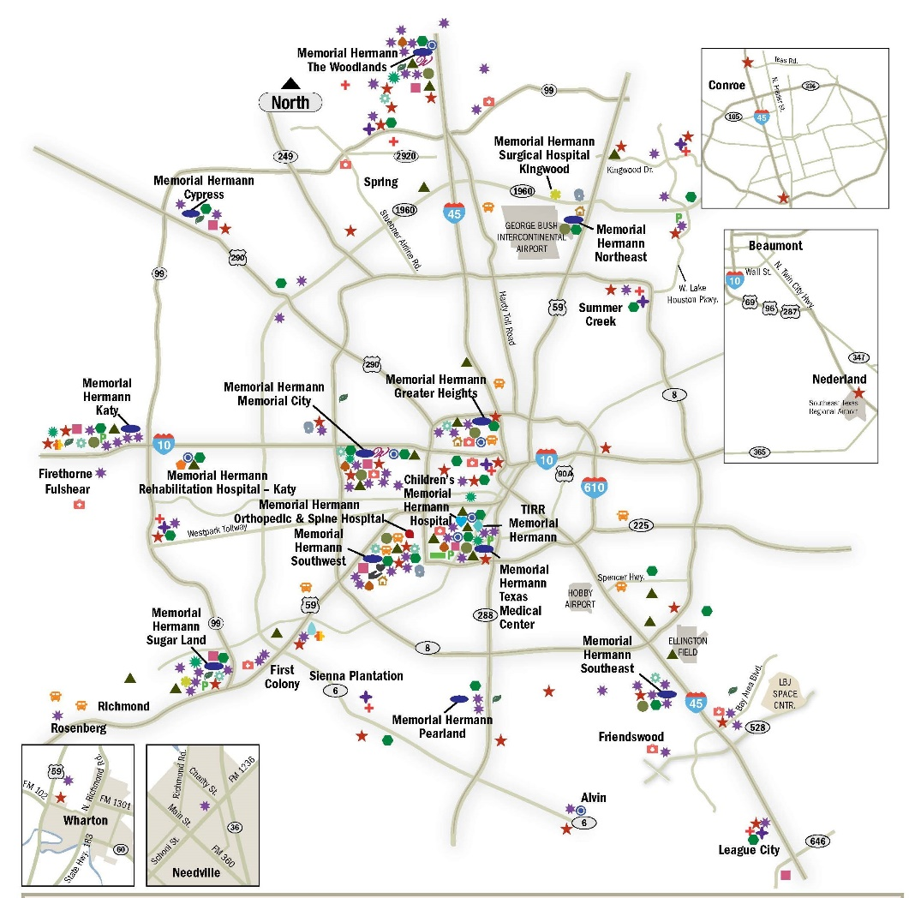
Facilities Network
Memorial Hermann Advantage is backed by the Memorial Hermann Health System —
a trusted name in Houston health care for more than 112 years.
With Memorial Hermann Advantage, you get a high level of care near where you live or work, because Memorial Hermann has numerous facilities throughout Greater Houston, including hospitals, imaging centers, specialty institutes and more.

Slide 5

Value-Added Programs

Slide 6
Healthy Advantage Wellness Program
The Memorial Hermann Healthy Advantage Wellness Program rewards members for certain health-related activities. We are offering a MasterCard gift card that can be used anywhere MasterCard is accepted.
Each reward will vary based on the type of service completed during the current plan year.
You do not have to return anything back to the plan. Also, we'll track your completed wellness activities
on your behalf!
$25 Annual Health Risk Assessment
$50 Annual Wellness/Comprehensive visit
$25 Breast Cancer screening
$50 Colon Cancer screening
$30 Retinal Eye Exam for Diabetics(excluding Glaucoma screening)*
*Subject to vision care benefit coverage as outlined in the Evidence of Coverage.
The Healthy Advantage Wellness Program and reward gift care are not a plan benefit. Gift card reward is not redeemable for cash.

Slide 7

Silver&Fit® Fitness Program
The Silver&Fit® Exercise and Healthy Aging program includes the following benefits*:
No-cost fitness facility access
Enjoy no-cost fitness facility memberships to a broad network of participating locations.
The Home Fitness Program
Choose up to two home fitness kits each benefit year to keep you active at home, even if you can't make it to a fitness facility.
Resource Library
Get The Silver Slate® newsletter along with Healthy Aging videos and booklets. Stay motivated and social by engaging in fitness challenges with your friends.
Silver&Fit Connected!™
Track and view your activity levels through wearable fitness devices or mobile applications.
Rewards program
Earn fun rewards like hats and collector pins for staying active.
*Visit SilverandFit.com to learn more.

Slide 8

Summary of Benefits

Slide 9
Plan Information
Benefit | HMO Plan | Plus HMO Plan | Prime Value MA Only HMO Plan | What you should know
Plan Counties | Harris, Montgomery, Fort Bend, Brazoria, Galveston, Liberty |  | Harris, Montgomery, Fort Bend | Brazoria County and the MA-Only Plan are new for 2023.
Monthly Premium | You pay nothing | $25 | You pay nothing +$125 Part B refund | In addition, you must keep paying your Medicare Part B premium.
Deductible | No deductible | No deductible | No deductible | These plans do not have a medical deductible.
Maximum Out-of-Pocket Responsibility (does not include prescription drugs) | You pay no more than $3,400 annually. | You pay no more than $3,400 annually. | You pay no more than $3,400 annually. | This is the most you pay for copays, coinsurance, and other costs for medical services for the 2023 calendar year.

Slide 10
Plan Information Cont.
Benefit | HMO Plan | Plus HMO Plan | Prime Value MA Only HMO Plan | What you should know
Inpatient Hospital Coverage | You pay $350 per stay | You pay $350 per stay. | You pay $500 per stay. | Our plans cover an unlimited number of days for an inpatient hospital stay. Requires prior authorization.
Outpatient Hospital Coverage | You pay $200 for each Medicare-covered outpatient hospital facility visit. | You pay $200 for each Medicare-covered outpatient hospital facility visit. | You pay $200 for each Medicare-covered outpatient hospital facility visit.
­­­Doctors Visits | Primary Care Physician Visit: You pay $0 per visit Specialist Visit: You pay $25 per visit | Primary Care Physician Visit: You pay $0 per visit Specialist Visit: You pay $20 per visit | Primary Care Physician Visit: You pay $0 per visit Specialist Visit: You pay $30 per visit | For detailed information regarding additional in office cost shares by Physician/Specialist, see the Medical Benefits Chart in Chapter 4 of the Evidence of Coverage (EOC). Please note: With limited exceptions, you must receive care from network providers.

Slide 11
Plan Information Cont.
Benefit | HMO Plan | Plus HMO Plan | Prime Value MA Only HMO Plan | What you should know
Preventive Care | You pay nothing | You pay nothing | You pay nothing | Any additional preventive services approved by Medicare during the contract year will be covered. For Colorectal Cancer Screenings, please note that a colonoscopy or sigmoidoscopy conducted for polyp removal or biopsy is a surgical procedure subject to the outpatient surgery cost sharing described later in this benefit grid.
Emergency Care | You pay $125 per visit | You pay $125 per visit | You pay $125 per visit | If you are admitted to the hospital within 48 hours, you do not have to pay your share of the cost for emergency care.
Urgent Care | You pay $25 per visit | You pay $25 per visit | You pay $25 per visit

Slide 12
Plan Information Cont.
Benefit | HMO Plan | Plus HMO Plan | Prime Value MA Only HMO Plan | What you should know
Diagnostic Labs | You pay nothing | You pay nothing | You pay nothing | Costs for these services may be different if received in an outpatient surgery setting.
Diagnostic Radiology Services (such as MRIs, CT and PET scans) | You pay $150 per test/procedure | You pay $150 per test/procedure | You pay $150 per test/procedure | Prior Authorization required for diagnostic radiology services.
Lab Services | You pay $0 per lab service | You pay $0 per lab service | You pay $0 per lab service
Therapeutic radiology services (such as radiation treatment for cancer) | You pay $25 per session | You pay $25 per session | You pay $25 per session
Outpatient X-rays | You pay $0 per x-ray | You pay $0 per x-ray | You pay $0 per x-ray

Slide 13
Plan Information Cont.
Benefit | HMO Plan | Plus HMO Plan | Prime Value MA Only HMO Plan | What you should know
Hearing Services | Medicare covered hearing exams: $20 Routine hearing exams: $0 Hearing Aid(s) per year: $400 annual benefit | Medicare covered hearing exams: $20 Routine hearing exams: $0 Hearing Aid(s) per year: $400 annual benefit | Medicare covered hearing exams: $20 Routine hearing exams: $0 Hearing Aid(s) per year: $400 annual benefit

Slide 14
Plan Information Cont.
Benefit | HMO Plan | Plus HMO Plan | Prime Value MA Only HMO Plan | What you should know
Dental Services | Preventive Dental: Covered up to $2,000 Comprehensive Dental: Covered up to $2,000 Medicare Covered Dental Services: $20 | Preventive Dental: Covered up to $2,500 Comprehensive Dental: Covered up to $2,500 Medicare Covered Dental Services: $20 | Preventive Dental: Covered up to $1,000 Comprehensive Dental: Covered up to $1,000 Medicare Covered Dental Services: $30 | Maximum of 2 visits per calendar year. Periodontal Limits: Periodontal scaling and root planning: 1 per site/quad every 2 years Full mouth debridement : 1 per 3 years Periodontal maintenance: 2 every calendar year For a complete description of this benefit, including any additional limitations and exclusions, please refer to the Liberty Dental outline.

Slide 15
Plan Information Cont.
Benefit | HMO Plan | Plus HMO Plan | Prime Value MA Only HMO Plan | What you should know
Vision Services | Exam to diagnose and treat diseases and conditions of the eye (including yearly glaucoma screening): You pay nothing Routine Eye Exam Performed by Optician/Optometrist/ Ophthalmologist: You pay $20 Eyewear (Contact Lenses, Eyeglasses (frames and lenses)): $200 annual benefit | Exam to diagnose and treat diseases and conditions of the eye (including yearly glaucoma screening): You pay nothing Routine Eye Exam Performed by Optician/Optometrist/ Ophthalmologist: You pay $20 Eyewear (Contact Lenses, Eyeglasses (frames and lenses)): $200 annual benefit | Exam to diagnose and treat diseases and conditions of the eye (including yearly glaucoma screening): You pay nothing Routine Eye Exam Performed by Optician/Optometrist/ Ophthalmologist: You pay $20 Eyewear (Contact Lenses, Eyeglasses (frames and lenses)): $200 annual benefit

Slide 16
Plan Information Cont.
Benefit | HMO Plan | Plus HMO Plan | Prime Value MA Only HMO Plan | What you should know
Wellness Programs | Silver&Fit® Program: You pay nothing | Silver&Fit® Program: You pay nothing | Silver&Fit® Program: You pay nothing | Memorial Hermann Advantage offers Silver&Fit® club membership, Home Fitness Program, fitness challenges and more.
Telehealth/ Virtual Care Services * | $0.00 copay for Nurse line. $0.00 copay for Telephonic Physician visits. $0.00 copay for virtual visit (Evisits) through Memorial Hermann | $0.00. copay for Nurse line. $0.00 copay for Telephonic Physician visits. $0.00 copay for virtual visit (Evisits) through Memorial Hermann | $0.00 copay for Nurse line. $0.00 copay for Telephonic Physician visits. $0.00 copay for virtual visit (Evisits) through Memorial Hermann | 24/7 Nurse line services through toll free telephone number. 24/7 Telephonic Physician visits available nationwide through Teladoc. Virtual visit (Evisit) through Memorial Hermann - hours are limited and is available throughout Texas. * Services scheduled through your physician’s office may be subject to corresponding cost share
Durable Medical Equipment/Supplies | You pay 20% coinsurance | You pay 20% coinsurance | You pay 20% coinsurance | Prior Authorization required for items over $500.

Slide 17
Plan Information Cont.
Benefit | HMO Plan | Plus HMO Plan | Prime Value MA Only HMO Plan | What you should know
Mental Health Services (including Inpatient) | Psychiatric Services: $25 Opioid Treatment Program Services: $20 Mental Health Specialist Non-Physician: $0 | Psychiatric Services: $20 Opioid Treatment Program Services: $20 Mental Health Specialist Non-Physician: $0 | Psychiatric Services: $30 Opioid Treatment Program Services: $30 Mental Health Specialist Non-Physician: $0 | Inpatient visit: Our plan covers an unlimited number of days for an inpatient hospital stay. Prior Authorization required.

Slide 18
Plan Information Cont.
Benefit | HMO Plan | Plus HMO Plan | Prime Value MA Only HMO Plan | What you should know
Skilled Nursing Facility | You pay nothing for days 1 through 20. You pay $125 per day for days 21 through 100. | You pay nothing for days 1 through 20. You pay $125 per day for days 21 through 100. | You pay nothing for days 1 through 20. You pay $125 per day for days 21 through 100. | Prior Authorization required.
Medicare Part B Drugs | For Part B drugs such as chemotherapy drugs: You pay 20% coinsurance Other Part B Drugs Including Allergy Injections: You pay 20% coinsurance | For Part B drugs such as chemotherapy drugs: You pay 20% coinsurance Other Part B Drugs Including Allergy Injections: You pay 20% coinsurance | For Part B drugs such as chemotherapy drugs: You pay 20% coinsurance Other Part B Drugs Including Allergy Injections: You pay 20% coinsurance
Foot Care (podiatry services) | Foot exams and treatment Routine Foot Care: You pay $25 | Foot exams and treatment Routine Foot Care: You pay $25 | Foot exams and treatment Routine Foot Care: You pay $30 | Limitations may apply.

Slide 19
Plan Information Cont.
Benefit | HMO Plan | Plus HMO Plan | Prime Value MA Only HMO Plan | What you should know
Rehabilitation Services | Cardiac (heart) Rehab Services: You pay $20 per visit Pulmonary Services: You pay $20 per visit Occupational Therapy Visit: You pay $20 per visit Physical Therapy and Speech and Language Therapy Visit: You pay $20 per visit | Cardiac (heart) Rehab Services: You pay $20 per visit Pulmonary Services: You pay $20 per visit Occupational Therapy Visit: You pay $20 per visit Physical Therapy and Speech and Language Therapy Visit: You pay $20 per visit | Cardiac (heart) Rehab Services: You pay $30 per visit Pulmonary Services: You pay $0 per visit Occupational Therapy Visit: You pay $30 per visit Physical Therapy and Speech and Language Therapy Visit: You pay $30 per visit

Slide 20
Plan Information Cont.
Benefit | HMO Plan | Plus HMO Plan | Prime Value MA Only HMO Plan | What you should know
Ambulance ground/Air | Ground: You pay $250 per one-way trip Air: 20% | Ground: You pay $250 per one-way trip Air: 20% | Ground: You pay $250 per one-way trip Air: 20%
Transportation | Memorial Hermann Advantage HMO covers 10 trips. | Memorial Hermann Advantage Plus HMO covers 15 trips. | Memorial Hermann Advantage Prime Value MA Only HMO covers 10 trips.
Over-the-Counter (OTC) | $40 per quarter | $55 per quarter | $25 per quarter
Meals | Coverage: (10) meals post-discharge of inpatient or surgical hospital stay | Coverage: (10) meals post-discharge of inpatient or surgical hospital stay | Coverage: (10) meals post-discharge of inpatient or surgical hospital stay

Slide 21

Dual Advantage HMO D-SNP

Slide 22
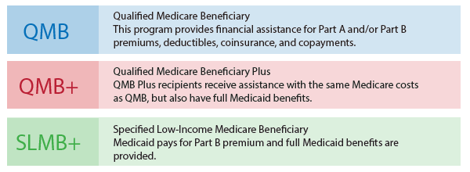
D-SNP
With Memorial Hermann Dual Advantage HMO D-SNP, members get exceptional care and coverage in an all-in-one plan that combines your Medicare Part A and Part B benefits, your Medicare Part D prescription drug coverage, your Medicaid benefits, as well as extra benefits not provided by either Medicare or Medicaid.
To qualify:
Be over the age of 65 and have both Medicare and Medicaid.
Or, be under 65 with a qualifying disability.
Individuals who meet one of these basic requirements must also be enrolled in Medicare Part A and/or Part B and receive full Medicaid benefits and/or assistance with Medicare premiums or cost sharing through one of the following “Medicare Savings Program” (MSP) categories:

Slide 23





D-SNP Benefits
With the Memorial Hermann Dual Advantage HMO D-SNP you will receive extra benefits and features:
Specifically designed for people with both Medicare and Medicaid.
You must reside in Harris, Montgomery, or Fort Bend County to qualify for this plan.
You can keep your Medicaid benefits and get more benefits compared with Original Medicare.
Extra Benefits You’ll Receive
Preventative and comprehensive dental coverage. Vision allowance of $200 and hearing allowance of $400 during benefit year. Transportation benefit includes 58 one-way transports to and from a Health-related location per year. Meal benefit includes 10 meals post-discharge after every surgery or inpatient discharge during the benefit year. OTC (Over-the-counter) Reimbursement up to $75 every 3 months.

Slide 24
D-SNP Benefits
Benefit | Coverage
Primary Care | Covered by Standard Medicare
Specialist Care | Covered by Standard Medicare
Lab testing | Covered by Standard Medicare
Inpatient treatment | Covered by Standard Medicare
Over-the-counter (OTC) | $75 per quarter
Meals | Coverage: (10) meals post-discharge of inpatient or surgical hospital stay
Extra Benefits You’ll Receive

Slide 25
D-SNP Benefits
Extra Benefits You’ll Receive
Benefit | Coverage
Transportation | Covered: 58 trips
Dental | Covered: $2,500 limit
Vision | Covered by Standard Medicare
Hearing | Covered by Standard Medicare
Telemedicine | Covered by Standard Medicare
Fitness | Covered by Standard Medicare

Slide 26

Pharmacy

Slide 27
Prescription Drug Coverage HMO, Plus HMO and
MA Prime Value HMO Plan:
2023 Memorial Hermann Prescription Drug Benefit
Total Yearly Drug Cost (Cost paid by you and our Part D plan) | $4,660.00
Cost-Sharing may change depending on the pharmacy you choose and when you enter another phase of the Part D benefit.
For more information on the additional pharmacy-specific cost-sharing and the phases of the benefit, please call us at 855.645.8448 (TTY 711) available 8 a.m. to 8 p.m. CST, seven days per week from October 1 – March 30 and 8 a.m. to 8 p.m. CST, Monday – Friday from April 1st - September 30; or access our Evidence of Coverage at healthplan.memorialhermann.org/medicare.
You may get your drugs at network retail pharmacies and mail order pharmacies. If you reside in a long-term care facility, you pay the same as at a retail pharmacy.

Slide 28
Prescription Drug Coverage Plan Highlights
What is a preferred pharmacy?
A preferred pharmacy are those pharmacies that will allow members to receive their drugs at a lower copay. There are many other pharmacies in-network, but the preferred pharmacies offer some savings on the copay payment.
What are the preferred pharmacies for the Memorial Hermann Medicare Advantage Golden Triangle Plan?
Memorial Hermann Pharmacy
Costco Retail Pharmacies
CVS
HEB
Walmart
New for 2023: Insulin Savings Program (Select Insulins)
$35 copay for Select Insulins (SI) at Preferred or Standard pharmacies for a 30-day supply. (Including through the Coverage Gap).
Select Insulins (SI) are limited insulin products that are selected as part of the CMS Senior Savings Model program at a reduced member copay.
Memorial Hermann Specialty Pharmacy is local and connected to the Memorial Hermann Health System.
Memorial Hermann has a specialty pharmacy, what does that mean to you?

Slide 29
HMO Plan and Plus HMO Plan Prescription Tier Highlights
What are Select Care drugs?
Select Care Drugs (Tier 6) are certain generic medications commonly used to treat diabetes, high blood pressure and cholesterol. These drug are available at preferred pharmacies and through mail order services at $0 copay.
Select Care Drugs (Tier 6) drugs are fully covered during coverage gap (donut hole) at $0 copay at preferred pharmacies or Costco mail order service!

Slide 30
Plan Prescription Highlights
New Preferred Diabetic Vendors
One Touch (LifeScan products) and Accu-Chek (Roche products ) are 0% coinsurance for preferred/exclusive brand of glucometer & test strips. Majority of our current members use these products and can enjoy savings! 20% coinsurance for all other Medicare-covered diabetic supplies.
Continuous Glucose Monitors (CGM) are covered at the Pharmacy!
Continuous Glucose Monitors (CGM) are covered through your pharmacy benefit. Please check the formulary for any restrictions and for tier information. Preferred CGM brands are DexCom G6 and Freestyle Libre. All others are excluded.
There is $0 Deductible for Part D Drugs for Coverage Year 2023!!! ​

Slide 31
HMO and Plus HMO Initial Coverage: Retail Cost-Sharing
Tier | One-Month Supply at a Preferred Pharmacy | One-Month Supply at a Non-Preferred Pharmacy | Three-Month Supply at a Preferred Pharmacy | Three-Month Supply at a Non-Preferred Pharmacy
Tier 1 (Preferred Generic) | $0.00 | $10.00 | $0.00 | $20.00
Tier 2 (Generic) | $5.00 | $18.00 | $10.00 | $36.00
Tier 3 (Preferred Brand) | $39.00 | $47.00 | $78.00 | $94.00
Tier 4 (Non-Preferred Brand) | $92.00 | $100.00 | $184.00 | $200.00
Tier 5 (Specialty Tier Drugs) | 33% | 33% | N/A | N/A
Tier 6 (Select Care Drugs) | $0.00 | $8.00 | $0.00 | $16.00

Slide 32
HMO and Plus HMO Initial Coverage: Mail Order Cost-Sharing
Tier | 90 Day Supply
Tier 1 (Preferred Generic) | $0.00
Tier 2 (Generic) | $10.00
Tier 3 (Preferred Brand) | $78.00
Tier 4 (Non-Preferred Brand) | $184.00
Tier 5 (Specialty Tier Drugs) | 33%
Tier 6 (Select Care Drugs) | $0.00

Slide 33
Coverage Gap & Catastrophic Coverage
Coverage Gap:
Most Medicare drug plans have a coverage gap (also called the "donut hole"). This means that there's a temporary change in what you will pay for your drugs. The coverage gap begins after the total yearly drug cost (including what our plan has paid and what you have paid) reaches $4,660.
After you enter the coverage gap, you pay 25% of the price for brand name drugs, plus a portion of the dispensing fee and 25% of the price for generic drugs.
Not everyone will enter the coverage gap.
Catastrophic Coverage:
After your yearly out-of-pocket drug costs (including drugs purchased through your retail pharmacy and through mail order) reach $7,400, you pay the greater of:
5% of the cost, or
$4.15 copay for generic or a preferred multi-source drug (including brand drugs treated as generic) and a
$10.35 copay for all other drugs

Slide 34

Questions?
memorialhermannadvantage.org
866.432.4916 (TTY 711)

Slide 35

Language Support Services
*Resources are available for the visually impaired.
Memorial Hermann Advantage complies with applicable Federal civil rights laws and does not discriminate on the basis of race, color, national origin, age, disability, or sex.
This information is not a complete description of benefits. Call 855.645.8448 (TTY 711) for more information.
Copyright © 2022 Memorial Hermann. All rights reserved.
H7115_MKAEPHMOPres23r1_M CMS Approved 10/19/2022

Slide 36
Memorial Hermann Advantage complies with applicable Federal civil rights laws and does not discriminate on the basis of race, color, national origin, age, disability, or sex. Memorial Hermann Advantage does not exclude people or treat them differently because of race, color, national origin, age, disability, or sex.
Memorial Hermann Advantage:
Provides free aids and services to people with disabilities to communicate effectively with us, such as: Qualified sign language interpreters. Written information in other formats (large print, audio, accessible electronic formats, other formats)
Provides free language services to people whose primary language is not English, such as:
  Qualified interpreters
  Information written in other languages
If you need these services, contact Customer Service at the number below.
If you believe that Memorial Hermann Advantage has failed to provide these services or discriminated in another way on the basis of race, color, national origin, age, disability, or sex, you can file a grievance with:
Civil Rights Coordinator, Memorial Hermann Health Plan, 929 Gessner Road, Suite 1500, Houston, TX 77024
855.645.8448 (TTY 711) 8 a.m. to 8 p.m. 7 days a week CST.
Fax 713.338.6487
Email MHHealthAppeals@memorialhermann.org
You can file a grievance in person or by mail, fax, or email. If you need help filing a grievance, the Civil Rights Coordinator is available to help you. You can also file a civil rights complaint with the U.S. Department of Health and Human Services, Office for Civil Rights electronically through the Office for Civil Rights Complaint Portal, available at https://ocrportal.hhs.gov/ocr/portal/lobby.jsf, or by mail or phone at: U.S. Department of Health and Human Services, 200 Independence Avenue SW., Room 509F, HHH Building, Washington, DC 20201,
1.800.368.1019, 800.537.7697 (TDD).
Complaint forms are available at http://www.hhs.gov/ocr/office/file/index.html.

