Slide 1
MEMORIAL HERMANN MEDICARE ADVANTAGE
2026 HMO PLANS

Slide 2


Meeting Agenda
Today’s meeting will cover:
Memorial Hermann Advantage Qualifications
Memorial Hermann Value Proposition
Provider Network
Summary of Benefits
Supplemental Benefit Information
Pharmacy
Value-Added Programs
D-SNP
Q&A

Slide 3
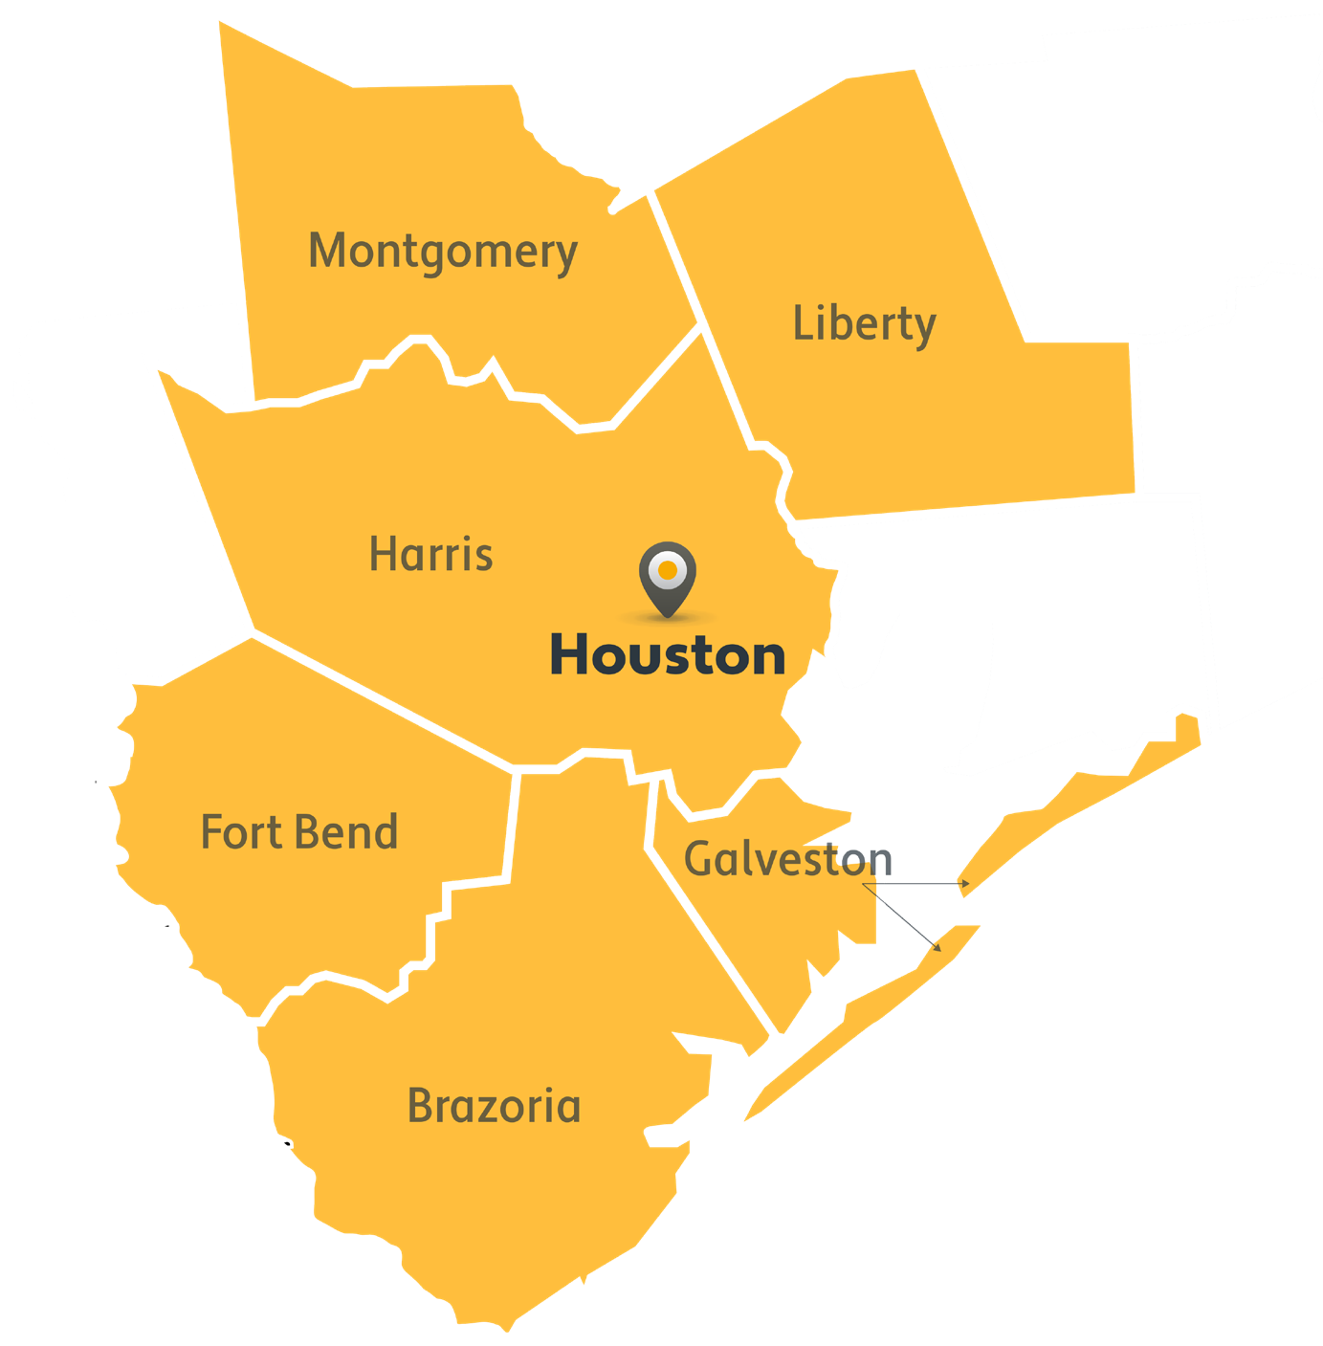
Are you qualified for Memorial Hermann Advantage?
In order to be eligible for Memorial Hermann Advantage, you must reside in our coverage area, which includes:
Harris County
Montgomery County
Fort Bend County
Liberty County
Galveston County
Brazoria County
You must also be enrolled in Medicare Part A and B.

Slide 4

Medicare Advantage Qualifications
You must be enrolled in Medicare Part A & Medicare Part B
  Medicare Part A (Hospital Insurance)
  Medicare Part B (Medical Insurance)
Be a United States citizen or be lawfully present in the U.S.
Live in the plan's service area
When can I enroll?
Between October 15-December 7 each year (for coverage starting January 1)
Within 3 months of first getting Medicare
7 months to enroll into MAPD/PDP plan: three months prior to the eligibility month, month of eligibility and three months after eligibility month

Slide 5
Our WHY
A known, respected, LOCAL brand. We are a local plan, serviced locally, to better serve our members and our communities. Memorial Hermann has been helping fellow Texans in the Houston area for over 100 years.
Access to Top-Notch Care with No Referrals. The Memorial Hermann Health System includes over 17 hospitals, 70 clinics, and over 6,700 physicians. And, while we encourage and facilitate establishing a relationship with your PCP to coordinate care, when you’re in our network there are no referrals needed to see a specialist.
Care Coordination: Member – Physician – Pharmacy. We use proprietary technology that efficiently shares valuable information and identifies opportunities for value-based care improvement.
Growth Trajectory. We are investing in our products and our broker partners to significantly drive expansion and growth.

Slide 6
Memorial Hermann Provider Network
Your plan includes over 17 hospitals, 70 clinics, and over 7,000 physicians across the Memorial Hermann Health System. We also are partnered with a select group of in-network providers.
Memorial Hermann’s Network includes the following:
Village Medical Group
UTMB
Unity Physicians
New Wave Physicians
Northwest Internal Medicine
UT Physicians

Slide 7
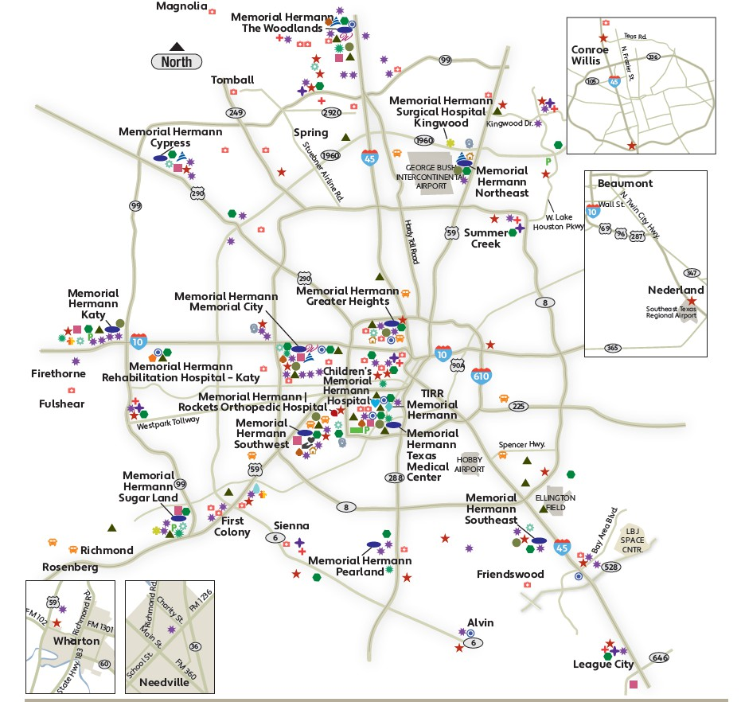
Facilities Network
Memorial Hermann Advantage is backed by the Memorial Hermann Health System —
a trusted name in Houston health care for more than 112 years.
With Memorial Hermann Advantage, you get a high level of care near where you live or work, because Memorial Hermann has numerous facilities throughout Greater Houston, including hospitals, imaging centers, specialty institutes and more.

Slide 8



2026 Plan Benefits
HMO
MA Only (Prime Value Plan)
Dual Special Needs Plan (DSNP)

Slide 9
Plan Information
Benefit | HMO Plan | Prime Value MA Only HMO Plan | What you should know
Plan Counties | Harris, Montgomery, Fort Bend, Brazoria, Galveston and Liberty | Harris, Montgomery, Fort Bend, Brazoria, Galveston and Liberty
Monthly Premium | You pay $0 | You pay $0 Includes a $175 Part B refund | In addition, you must keep paying your Medicare Part B premium. – Only applies to HMO Plan.
Deductible | No deductible | No deductible | These plans do not have a medical deductible.
Maximum Out-of-Pocket Responsibility (does not include prescription drugs) | You pay no more than $3,400 annually. | You pay no more than $3,950 annually. | This is the most you pay for copays, coinsurance, and other costs for medical services for the 2026 calendar year.

Slide 10
Plan Information Cont.
Benefit | HMO Plan | Prime Value MA Only HMO Plan | What you should know
Doctors Visits | Primary Care Physician Visit: You pay $0 per visit Specialist Visit: You Pay $25 | Primary Care Physician Visit: You pay $0 per visit Specialist Visit: You Pay $40
Preventive Care | You pay nothing | You pay nothing | Any additional preventive services approved by Medicare during the contract year will be covered. For colorectal cancer screenings, please note that a colonoscopy or sigmoidoscopy conducted for polyp removal or biopsy is a surgical procedure subject to the outpatient surgery cost sharing described later in this benefit grid.
Lab Services | You pay nothing | You pay nothing
Outpatient X-rays | You pay nothing | You pay nothing

Slide 11
Plan Information Cont.
Benefit | HMO Plan | Prime Value MA Only HMO Plan | What you should know
Urgent Care | You pay $30 | You pay $30
Emergency Care | You pay $150 | You pay $150 | If you are admitted to the hospital within 48 hours, you do not have to pay your share of the cost for emergency care.
Inpatient Hospital Coverage | You pay $400/per stay | You pay $750/per stay | Our plans cover an unlimited number of days for an inpatient hospital stay. Requires prior authorization.
Outpatient Hospital Services -Surgery | You pay $150 for each Medicare-covered outpatient hospital facility visit. | You pay $200 for each Medicare- covered outpatient hospital facility visit.

Slide 12
Plan Information Cont.
Benefit | HMO Plan | Prime Value MA Only HMO Plan | What you should know
Diagnostic Radiology Services (such as MRI’s, CT and PET scans) | You pay $150 test/procedure | You pay $150 test/procedure | Prior Authorization required for diagnostic radiology services.
Therapeutic radiology services (such as radiation treatment for cancer) | You pay $25 | You pay $25
Ambulance - ground/air | Ground: You pay $250 per one- way trip Air: 20% | Ground: You pay $250 per one- way trip Air: 20%
Telehealth/Virtual Care Services* | $0 copay for Nurse line, $0 (Teladoc) $0 Virtual visits (Evisits) through Memorial Hermann | $0 copay for Nurse line. $0 (Teladoc) $0 Virtual visits (Evisits) through Memorial Hermann | 24/7 Nurse line services through toll free number. 24/7 Telephonic Physician visits available nationwide through Teladoc. Virtual visit through MH – hours are limited and is available throughout Texas. *Services scheduled through your physicians office may be subject to corresponding cost share

Slide 13
Plan Information Cont.
Benefit | HMO Plan | Prime Value MA Only HMO Plan | What you should know
Mental Health Services (including inpatient) | Psychiatric Services: $25 Opioid Treatment Program Services: $25 Mental Health Specialist Non- Physician: $0 | Psychiatric Services: $40 Opioid Treatment Program Services: $40 Mental Health Specialist Non- Physician: $0 | Inpatient visit: Our plan covers an unlimited number of days for an inpatient hospital stay. Prior authorization required.
Rehabilitation Services | Cardiac Rehab: $25 Pulmonary: $25 Occupational Therapy Visit: $25 Physical Therapy & Speech Language Therapy Visit: $25 | Cardiac Rehab: $40 Pulmonary: $40 Occupational Therapy Visit: $40 Physical Therapy & Speech Language Therapy Visit: $40
Durable Medical Equipment/Supplies | You pay 20% coinsurance | You pay 20% coinsurance | Prior authorization required for items over $500

Slide 14
Plan Information Cont.
Benefit | HMO Plan | Prime Value MA Only HMO Plan | What you should know
Skilled Nursing Facility | You pay nothing for days 1 through 20. You pay $125 per day for days 21 through 100. | You pay nothing for days 1 through 20. You pay $125 per day for days 21 through 100. | Prior Authorization required.
Medicare Part B Drugs | For Part B drugs such as chemotherapy drugs: You pay 20% coinsurance Other Part B drugs including Allergy injections: You pay 20% coinsurance | For Part B drugs such as chemotherapy drugs: You pay 20% coinsurance Other Part B drugs including Allergy injections: You pay 20% coinsurance | Prior authorization may be required for some Part B Drugs.
Foot Care (podiatry services) | Foot exams and routine foot care treatment: You pay $25 | Foot exams and routine foot care treatment: You pay $40 | Limitations may apply.

Slide 15
Plan Information Cont.
Benefit | HMO Plan | Prime Value MA Only HMO Plan | What you should know
Comprehensive Dental | Covered up to $2,500 | Covered up to $1,000 | Covered through Liberty Dental. Preventive 100% Basic & Major services: Copay per service, see Dental Schedule of Benefits for exact copays.
Transportation | MHHP covers 20 one-way trips | Not covered
Meals | 10 meals post discharge of inpatient or surgical hospital stay | 10 meals post discharge of inpatient or surgical hospital stay
Flex Card | $500/Vision, $500/Hearing Allowance OTC: $50/quarter via catalog or brick-and-mortar pharmacy locations. Groceries: $80/quarter | $300/Vision, $600/Hearing Allowance OTC: Not Covered. Groceries: $40/quarter

Slide 16
SUPPLEMENTAL BENEFIT INFORMATION

Slide 17
Dental
Liberty Dental (5th Year) / PPO
– Please note: out of network services must be paid at time of service and submitted for reimbursement via claim reimbursement form
Preventive/comprehensive included
Co-pays for each service for member clarity
Helpful Member Information:
  Liberty has an excellent network in the Houston area, and members can find a provider by calling Liberty at: 866.674.0114 (TTY: 877.855.8039).
  Or, the member can visit the Liberty website at: https://client.libertydentalplan.com/MemorialHermannMedicare/FindADentist

Slide 18
Transportation
Increased need as Houston grows
20 trips for the base (HMO) plan
– No Transportation for MA-Only (Prime Value) plan
Helpful Member Information:
Members can call Modivcare directly to reserve a ride (recommend three days in advance when possible): 855.330.9138
Or, visit their website at www.mymodivcare.com and click “Book a Ride.” Member will be instructed to set up a username and password, which can be used to quickly log-in and book future trips.

Slide 19
Meals
10 prepared meals delivered to member post in-patient hospitalization
Available on all plans
Helpful Member Information:
If the member is working with a Case Manager already, the Case Manager can order the meals after the member has been discharged.
The Member also has up to 14 days post discharge to order the meals themselves by calling Memorial Hermann Customer Service at: 855.645.8448 (TTY: 711).
Meals typically arrive in 2-3 days and can be refrigerated for up to two weeks.

Slide 20
Flexible Spending Card
Vision/Hearing amounts
OTC – Quarterly via catalog (Medline) or brick-and-mortar
> MA Only (Prime Value) not covered
Automatic Grocery Benefit for all plans
Flex card includes web site address for member portal:
  Check balances
  Review purchases/locations
  Request reimbursement if card wasn’t available
  App also available

Slide 21
PHARMACY
2026 PHARMACY UPDATES

Slide 22
Prescription Drug Coverage Plan Highlights
2026 Highlights:
No coverage gap (“Donut Hole”) phase
$2,100 out-of-pocket maximum for Part D
Optional monthly payment plan (M3P)
  Helps members manage their out-of-pocket Medicare Part D drug costs by spreading them across the calendar year (January-December).
Specific to the Memorial Hermann Health Plan Part D Benefit:
Simplified Pharmacy Network - no “preferred” pharmacy network
$0 copay on Tier 1 drugs
Mail order available via Costco Mail Order
Specialty drugs available at Costco Specialty Pharmacy & Memorial Hermann Specialty Pharmacy
Formulary insulins – up to $35 max for 1 month supply
Part D vaccines fully covered (refer to your 2026 formulary)

Slide 23
MHHP Prescription Highlights
Preferred Diabetic Vendors
Roche (Accu-chek)and Ascencia (Contour) will be the preferred diabetic glucometer and related supplies (such as test strips) for 2026.
20% coinsurance for all other Medicare-covered diabetic supplies.
Continuous Glucose Monitors (CGM) are covered at the Pharmacy!
Continuous Glucose Monitors (CGM) are covered through your pharmacy benefit. Please check the formulary for any restrictions and for tier information. Preferred CGM brands are DexCom G6/G7 and Freestyle Libre products.
  Other brands and manufacturers may be covered if your doctor or provider tells us that the preferred brand is not appropriate for your medical needs.

Slide 24
HMO Initial Coverage: Retail Cost-Sharing
$200 deductible
- Applies to Tier 3, 4 & 5 only
Tier | One-Month Supply at a Preferred Pharmacy | Three-Month Supply at a Pharmacy
Tier 1 (Preferred Generic) | $0.00 | $0.00
Tier 2 (Generic) | $5.00 | $15.00
Tier 3 (Preferred Brand) | 23% | Total cost x 23%
Tier 4 (Non-Preferred Drugs) | 44% | Total cost x 44%
Tier 5 (Specialty) | 30% | N/A

Slide 25
Mail Order Cost-Share- Costco Mail Order
Tier | 90 Day Supply
Tier 1 (Preferred Generic) | $0.00
Tier 2 (Generic) | $15.00
Tier 3 (Preferred Brand) | 23%
Tier 4 (Non-Preferred Brand) | 44%
Tier 5 (Specialty Tier Drugs) | N/A

Slide 26
VALUE-ADDED PROGRAMS
2026 PROGRAMS

Slide 27


Silver&Fit® Fitness Program
The Silver&Fit® Exercise and Healthy Aging program includes the following benefits*:
No-cost fitness facility access
Enjoy no-cost fitness facility memberships to a broad network of participating locations. Participating locations including 24-hour Fitness, local YMCAs, and Planet Fitness, and more.
Silver&Fit Connected!
Track and view your activity levels through wearable fitness devices or mobile applications.
Rewards program
Earn fun rewards like hats and collector pins for staying active.
The Home Fitness Program
Choose one home fitness kit, including free Fit Bit, yoga mat and more each benefit year to keep you active at home, even if you can't make it to a fitness facility.
*Visit SilverandFit.com to learn more.
Resource Library
Get The Silver Slate® newsletter along with Healthy Aging videos and booklets. Stay motivated and social by engaging in fitness challenges with your friends.

Slide 28
Healthy Advantage Wellness Program
The Memorial Hermann Healthy Advantage Wellness Program rewards members for certain health-related activities.
-Reward amounts will be loaded onto your Flex Card
Each reward will vary based on the type of service completed during the current plan year.
You do not have to return anything back to the plan. Also, we'll track your completed wellness activities on your behalf!
$25 Annual Health Risk Assessment
$50 Annual Wellness/Comprehensive visit
$25 Breast Cancer screening
$50 Colon Cancer screening
$30 Retinal Eye Exam for Diabetics (excluding Glaucoma screening)*
*Subject to vision care benefit coverage as outlined in the Evidence of Coverage.
The Healthy Advantage Wellness Program and reward amounts are not redeemable for cash.

Slide 29
DUAL ADVANTAGE HMO (D-SNP)
2026 D-SNP PLAN

Slide 30
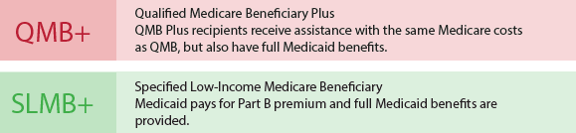
D-SNP Plan
With Memorial Hermann Dual Advantage HMO D-SNP, members get exceptional care and coverage in an all-in-one plan that combines your Medicare Part A and Part B benefits, your Medicare Part D prescription drug coverage, your Medicaid benefits, as well as extra benefits not provided by either Medicare or Medicaid.
Be over the age of 65 and have both Medicare and Medicaid. Specifically designed for people with both Medicare and Medicaid.
You must reside in Harris, Montgomery, Fort Bend, Brazoria or Liberty County to qualify for this plan.
You can keep your Medicaid benefits and get more benefits compared with Original Medicare
Or, be under 65 with a qualifying disability
To qualify:
Individuals who meet one of these basic requirements must also be enrolled in Medicare Part A and/or Part B and receive full Medicaid benefits and/or assistance with Medicare premiums or cost sharing through one of the following “Medicare Savings Program” (MSP) categories:

Slide 31






D-SNP: What’s New for 2026
With the Memorial Hermann Dual Advantage HMO D-SNP you will receive extra benefits and features:
D-SNP Benefits 2026
Dental coverage $4,000
Vision - $500 / Hearing - $500 preloaded onto your Flex card Unlimited Health-related trips.
Meal benefit includes 10 meals post-discharge after every surgery or inpatient discharge during the benefit year.
$255 per quarter grocery benefit. – Flex Card
OTC (Over-the-counter) $205/per quarter. – Flex Card

Slide 32
D-SNP Benefits
Benefit | Coverage
Primary Care | Covered by Standard Medicare
Specialist Care | Covered by Standard Medicare
Lab testing | Covered by Standard Medicare
Inpatient treatment | Covered by Standard Medicare

Slide 33
D-SNP Benefits
Benefit | Coverage
Transportation | Covered: Unlimited Trips
Dental | Covered: $4,000 limit – Covered through Liberty Dental
Telemedicine | Included
Meals | Coverage: (10) meals post-discharge of inpatient or surgical hospital stay
Fitness | Included – through Silver&Fit
Flex Card
Over-the-counter (OTC) | $205 per quarter (no rollover)
Grocery | $255/per quarter (no rollover)
Vision & Hearing | $500 for each / pre-loaded onto Flex card
Pharmacy Benefits | $615 deductible - Present your Medicaid ID card and your DSNP card at the Pharmacy

Slide 34
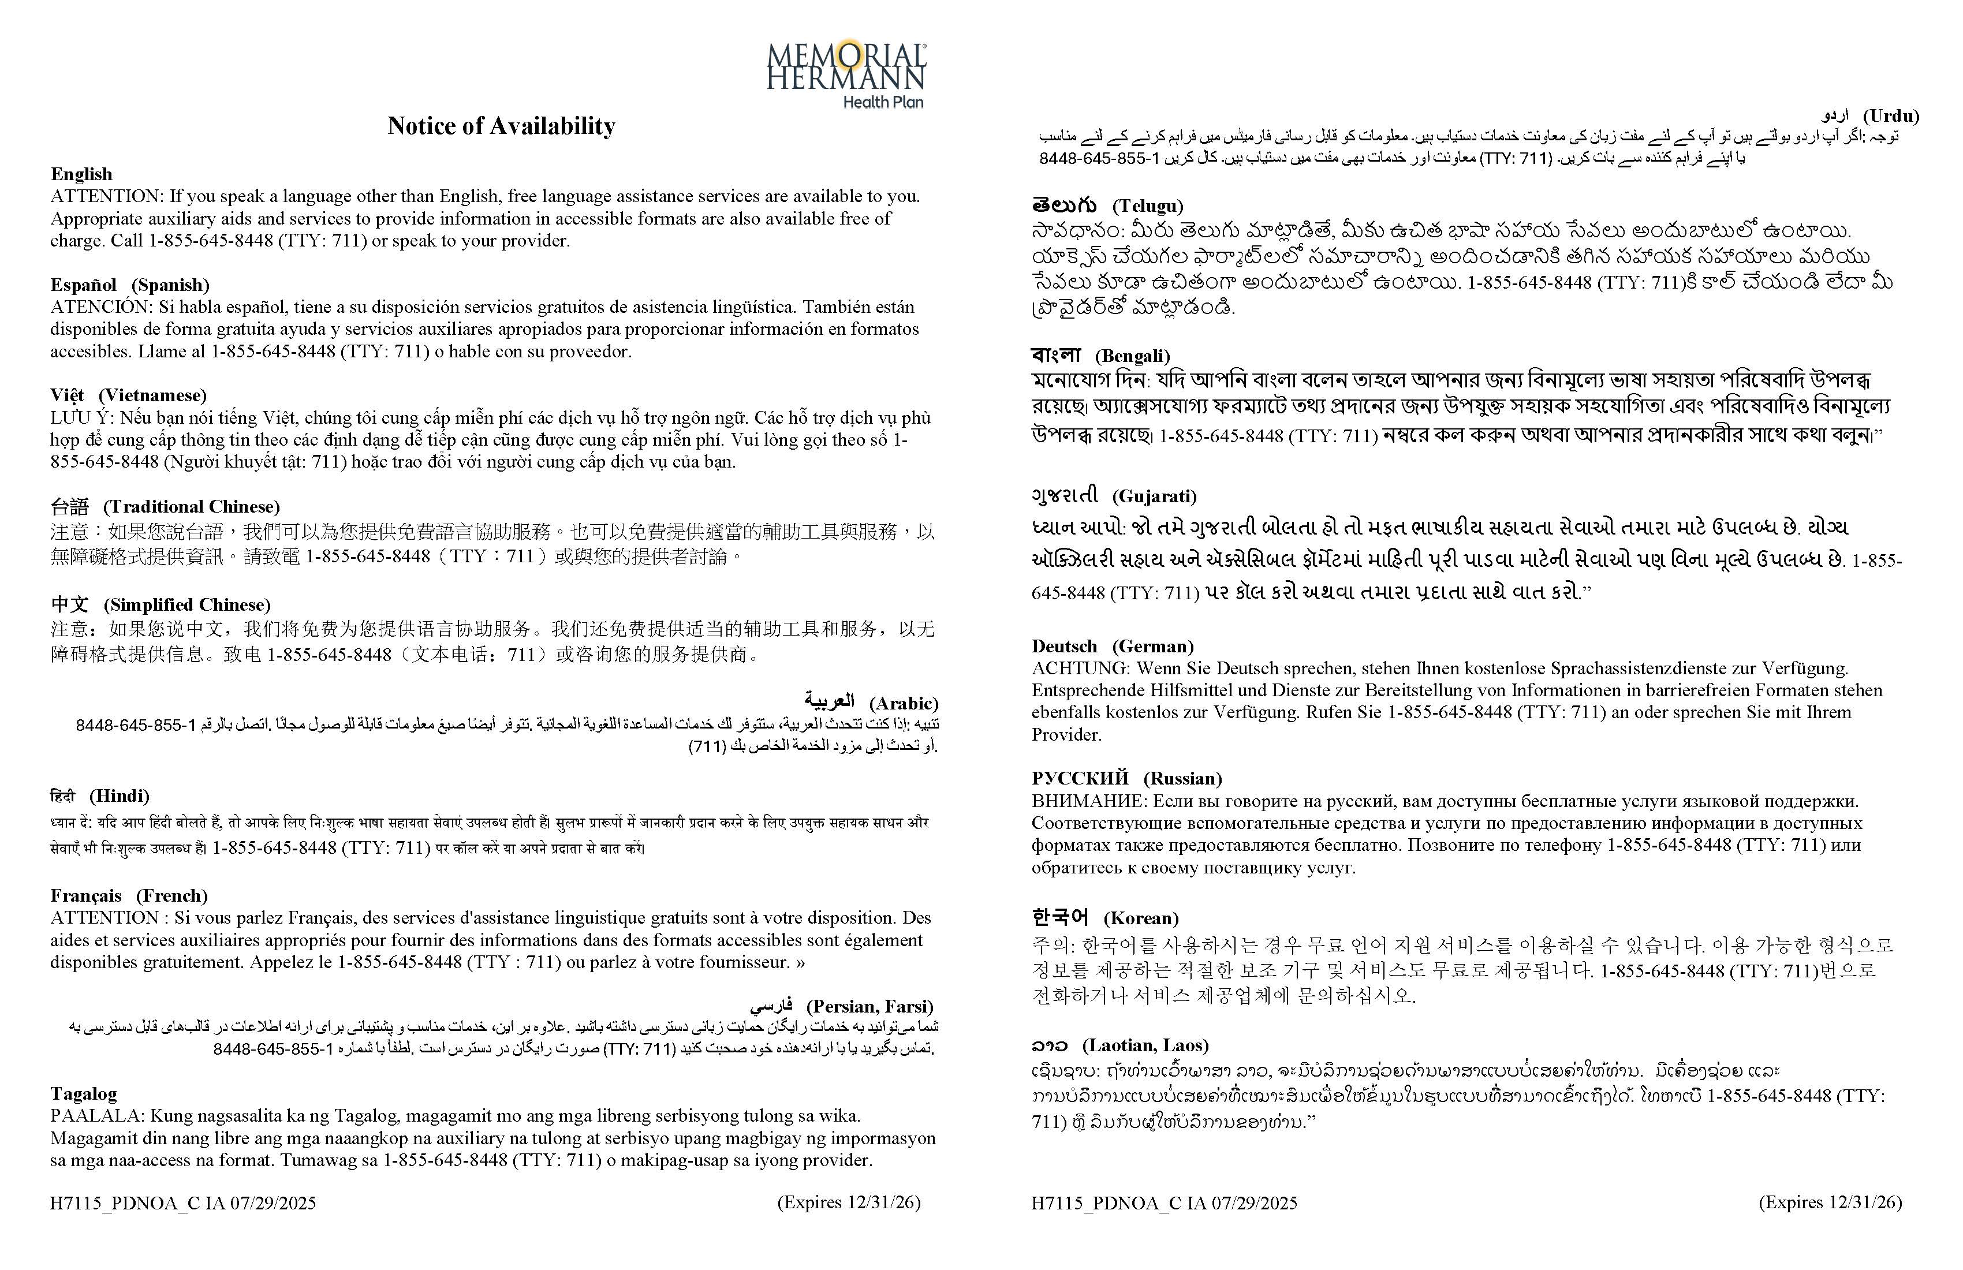
Language Support Services
Memorial Hermann Advantage complies with applicable Federal civil rights laws and does not discriminate on the basis of race, color, national origin, age, disability, or sex.
This information is not a complete description of benefits. Call 855.645.8448 (TTY 711) for more information.
Copyright © 2025 Memorial Hermann. All rights reserved.
Disclaimer: We may not offer every plan available in your area. Currently we represent Medicare Advantage organizations which offer different plan options in your area. Please contact Medicare.gov,
1-800-MEDICARE, or your local State Health Insurance Program (SHIP), to get information on all of your options.
Disclaimer: Memorial Hermann Health Plan’s Advantage HMO, Dual Special Needs Plan (DSNP), and Prime Value MA-Only HMO are plans with a Medicare contract. Enrollment in the Memorial Hermann Health Plan’s Advantage HMO, Dual Special Needs Plan (DSNP),
and Prime Value MA-Only HMO depends on contract renewal.
*Resources are available for the visually impaired.
H7115_MKAEPHMOPres26.2_M CMS Approved xx/xx/xxxx

Slide 35
Language Support Services
Memorial Hermann Advantage complies with applicable Federal civil rights laws and does not discriminate on the basis of race, color, national origin, age, disability, or sex. Memorial Hermann Advantage does not exclude people or treat them differently because of race, color, national origin, age, disability, or sex.
Memorial Hermann Advantage:
Provides free aids and services to people with disabilities to communicate effectively with us, such as: Qualified sign language interpreters. Written information in other formats (large print, audio, accessible electronic formats, other formats)
Provides free language services to people whose primary language is not English, such as: Qualified interpreters
Information written in other languages
If you need these services, contact Customer Service at the number below.
If you believe that Memorial Hermann Advantage has failed to provide these services or discriminated in another way on the basis of race, color, national origin, age, disability, or sex, you can file a grievance with:
Civil Rights Coordinator, Memorial Hermann Health Plan, 11740 Katy Freeway, 5th Floor., Houston, TX 77079 855.645.8448 (TTY 711) 8 a.m. to 8 p.m. 7 days a week CST.
Fax 713.338.6487
Email MHHealthAppeals@memorialhermann.org
You can file a grievance in person or by mail, fax, or email. If you need help filing a grievance, the Civil Rights Coordinator is available to help you. You can also file a civil rights complaint with the U.S. Department of Health and Human Services, Office for Civil Rights electronically through the Office for Civil Rights Complaint Portal, available at https://ocrportal.hhs.gov/ocr/portal/lobby.jsf, or by mail or phone at: U.S. Department of Health and Human Services, 200 Independence Avenue SW., Room 509F, HHH Building, Washington, DC 20201,
1.800.368.1019, 800.537.7697 (TDD).
Complaint forms are available at http://www.hhs.gov/ocr/office/file/index.html.

Slide 36

Questions?

